Slide 1
Teradata Overview & Architecture
Venkat M

Slide 2
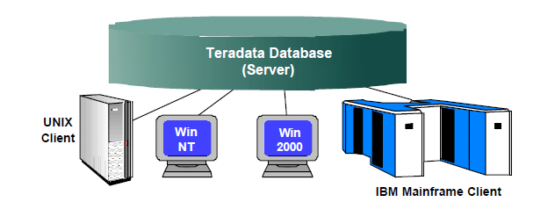
What is Teradata?
Teradata is a Relational Database Management System (RDBMS) that drives a company’s data warehouse
Teradata can run on UNIX or Windows 2000 server platforms
Capable of supporting many concurrent users from various client platforms
Teradata database is able to manage Terabytes of Data without any performance issues.
Built on a parallel architecture.
Notes:
Data warehouse term was coined by Bill Immon in 1990.
1. Query Parallelism
2. Data Placement for Parallel Performance
3. Intelligent Use of the Interconnect
4. The Parallel-Aware Optimizer
5. Synchronization of Parallel Activity

Slide 3
Why Teradata?
Supports more warehouse data
Supports easy scalability
Parallel-aware Optimizer
Automatic and even data distribution eliminates complex indexing schemes or time-consuming reorganizations
Designed and built with parallelism
High Availability - no single point of failure
Notes:
The Teradata Database was the first commercial database system to scale to and support a trillion bytes of data. The origin of the name Teradata is "tera-," which is derived from Greek and means "trillion.“.

Slide 4
Components and Architecture
Describe a node.
List the major components of the Teradata architecture and their functions
Describe the overall Teradata parallel architecture

Slide 5
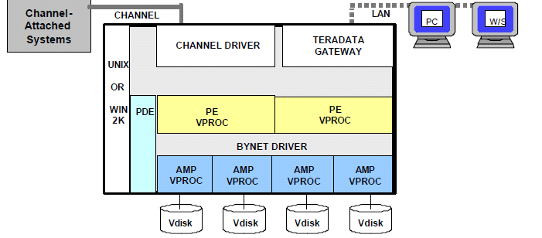
Teradata Node

Slide 6
Teradata Node
A node is made up of various hardware and software components
Teradata server runs under UNIX , or Windows
All Teradata software components(like PE and AMP) runs
Under the control of Teradata PDE(Teradata Parallel Database Extension)
AMPs are associated with disk space (vdisks), where the actual data is getting stored.
All AMPs and PEs communicate via the BYNET, which is a message passing Layer.

Slide 7
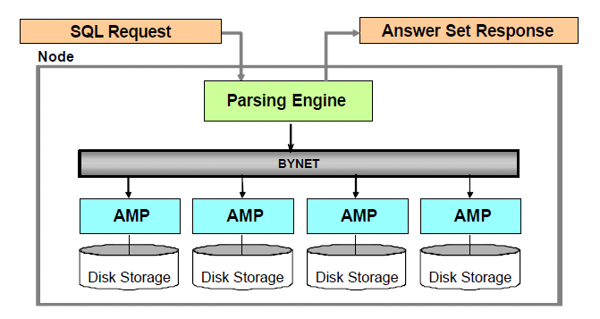
Major Components of a Node

Slide 8
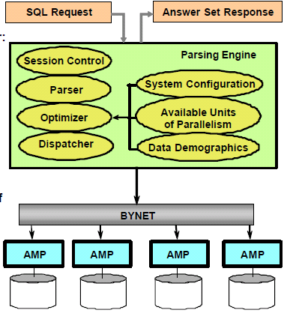
Parsing Engine
Notes:
Session Control:
Parser:
Optimizer:
Dispatcher:

Slide 9
Parsing Engine(PE) Cont.
A Parsing Engine (PE) is a virtual processor (vproc)
Once a valid session has been established with database, the PE manages the communication between the client application and the RDBMS
Each PE can handle up to 120 sessions
PE has the following components
1) Session Control : Session Control performs the logon and logoff functions.
2) Parser : The Parser interprets SQL statements, checks them for proper SQL syntax. It also checks the data dictionary to ensure all the objects exist and user have authority to access these objects.

Slide 10
Parsing Engine(PE) Cont.
3) Optimizer
The Optimizer is responsible for developing the least expensive plan to return the requested response set
This plan is then converted to executable steps to be performed by the AMP’s which is then passed to the dispatcher.
It is aware of number of nodes connected.
4) Dispatcher
The Dispatcher controls the sequence in which the steps are executed and passes the steps on to the BYNET
It is composed of execution control and response-control tasks

Slide 11
Parsing Engine(PE) Cont.
Summary of Activities:
Parse the SQL to determine type and validity
Validate user privileges
Optimize the access path(s) to retrieve the rows
Build an execution plan with necessary steps for row access
Send the plan steps to Access Module Processors (AMP) involved
Notes:
Each AMP is associated with its own disk, it is not allowed to use other amp’s disk hence it is also called “SHARED NOTHING ARCHITECTURE”.

Slide 12
Access Module Processor (AMP)
The Access Module Processor (AMP) is the virtual processor (vproc) which is responsible for managing a portion of the database
AMPs do the physical work associated with generating an
answer set, including sorting, aggregating, formatting and converting
An AMP responds to the steps sent by parser by storing data to or retrieving data from the disks associated with it.
The AMPs perform all database management functions in the system
Notes:
Each AMP is associated with its own disk, it is not allowed to use other amp’s disk hence it is also called “SHARED NOTHING ARCHITECTURE”.

Slide 13
AMP’s and Vdisks
AMPs are responsible for:
Storing and retrieving rows to and from disks
Lock management
Sorting rows and Aggregating columns
Join processing
Creating answer sets for clients
Disk space management
Each AMP is assigned to a vdisk
A vdisk is all the storage space assigned to an AMP
All the data finally resides in the vdisks.

Slide 14
BYNET(Message passing layer)
The amazing thing about the BYNET is its capacity
Instead of a fixed bandwidth that is shared among multiple nodes, the bandwidth of the BYNET increases as the number of nodes increase.
BYNET uses virtual circuits instead of using a single fixed cable or a twisted pair configuration.
Two different aspects of BYNET performance :
1) speed
2) Connection availability
Notes:
Speed :
Each path of the BYNET provides bandwidth of 10 Megabytes (MB) per second with Version 1 and 60 MB per second with Version 2. Therefore the aggregate speed of the two connections is 20MB/second or 120MB/second.
Connection availability :
BYNET uses the two connections for availability. Regardless of the speed associated with each BYNET connection, if one of the connections should fail, the second is completely independent and can continue to function at its individual speed without the other connection. Therefore, communications continue to pass between all nodes.

Slide 15
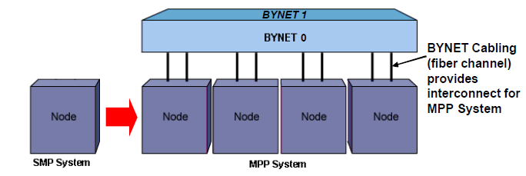
SMP and MPP systems
A single Teradata node system is known as Symmetric Multi-Processor system(SMP).
Multiple Teradata nodes connected together forms an MPP (Massively Parallel Processing System)
The BYNET connects multiple Teradata nodes together to create an MPP system

Slide 16
MPP system
An MPP system has two BYNET networks (BYNET 0 and BYNET 1)
Traffic is automatically and dynamically distributed between the BYNETs
If BYNET 0 fails, all the messages are re-routed to BYNET 1, and vice versa
The BYNET can currently support 512 nodes

Slide 17
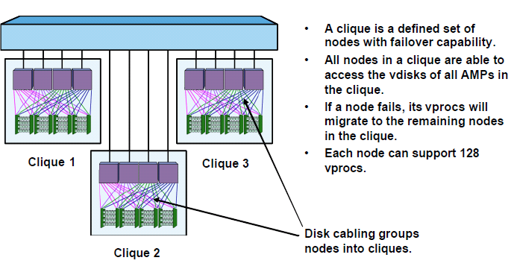
Cliques

